Slide 1
SAR on GEE, integration with other data: Flood Mapping Using Google Earth Engine
James Nyaga
Regional Centre for Mapping of Resources for Development (RCMRD)
AfriGEO 4th- 5th, Nov 2022 - Flood Mapping Training Accra, Ghana

Slide 2
Outline
Introduction/Background
Statement of the problem
Objectives
Methodology/Implementation Plan/Activities
Final/Preliminary Results/Outputs
Conclusion/Expected outcomes
Expected/Proposed Application Areas
Stakeholders and Users

Slide 3
Introduction/Background
https://www.worldvision.org/disaster-relief-news-stories/2019-cyclone-idai-facts
March 14th 2019 Idai makes landfall in Beira, Mozambique as Category 2 storm, heavy rains and strong winds
Six weeks later, April 25 Cyclone Kenneth affects Northern Mozambique about 600km north of impact zone
2.2 million people in Mozambique, Zimbwabwe and Malawi were affected
Vulnerability aspects – the region had just come from a drought phase to heavy flooding – food prices were high

Slide 4
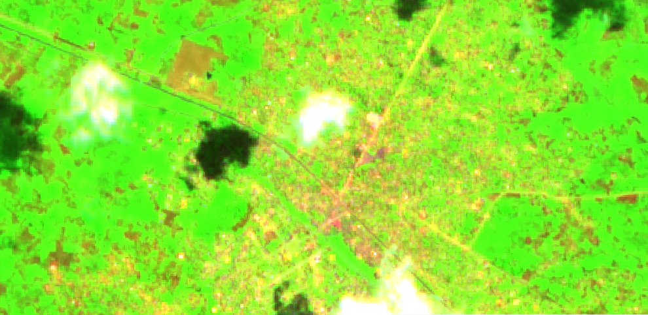
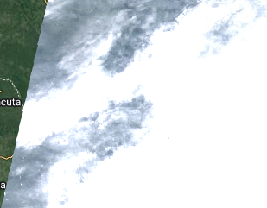
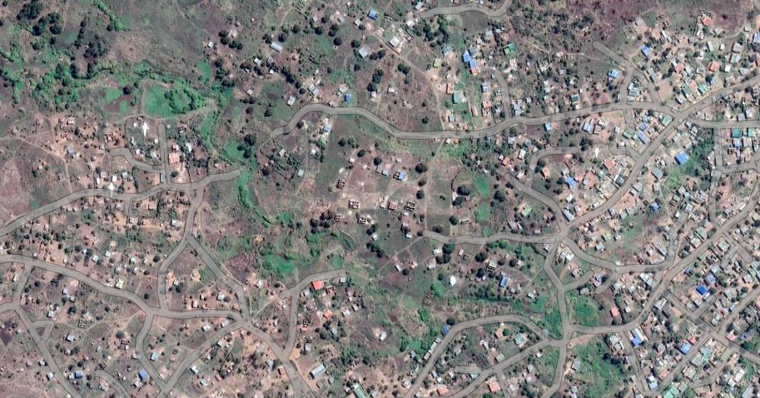
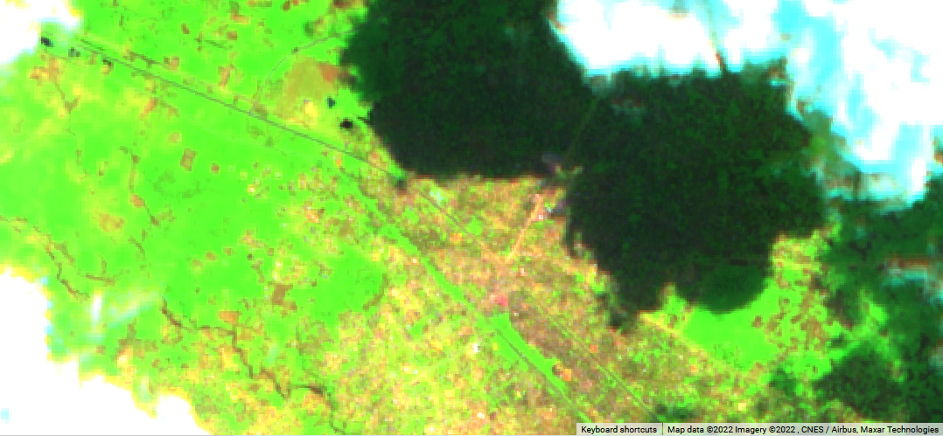
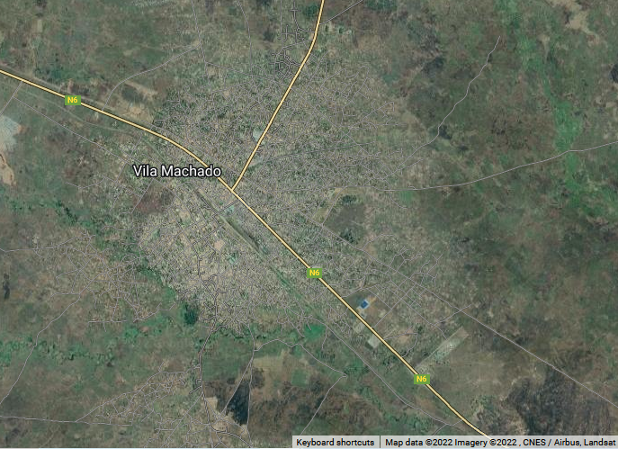
Introduction/Background
Landsat was too cloudy to analyze
Sentinel 2 had cloudy usable scenes
Villa Machado
Mar, 10
Mar, 25

Slide 5
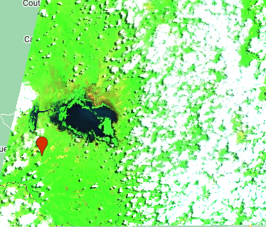
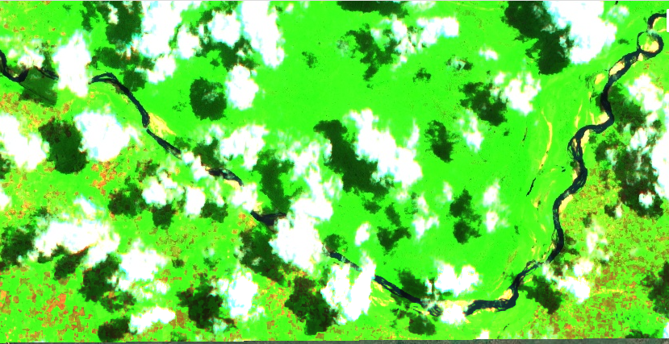
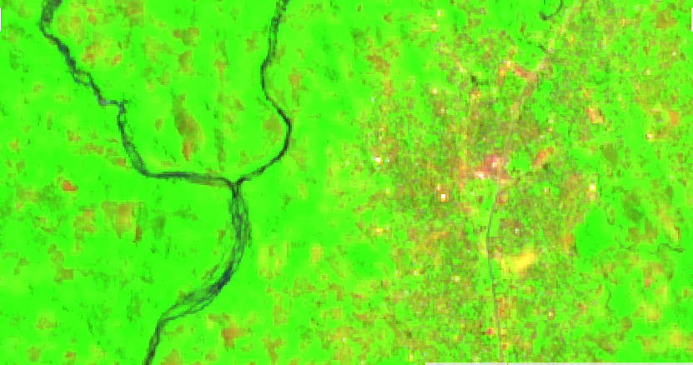
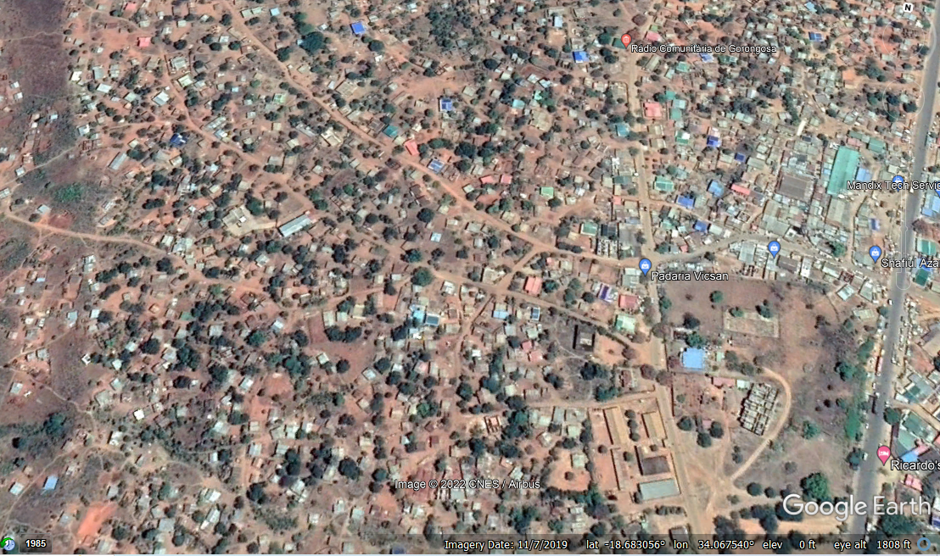
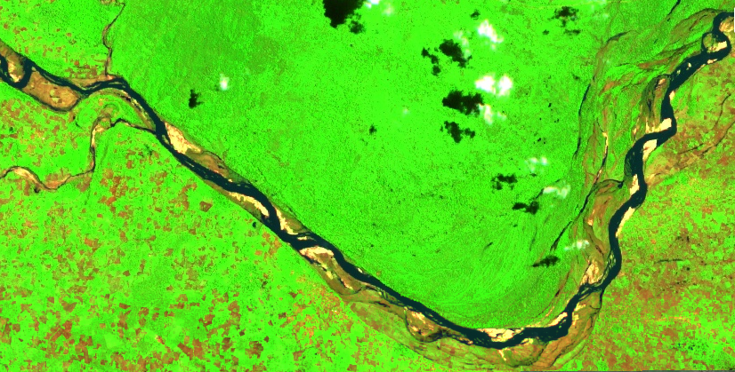
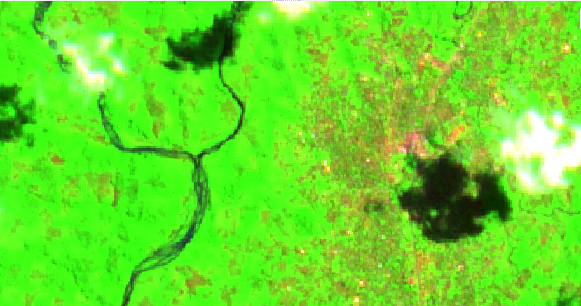
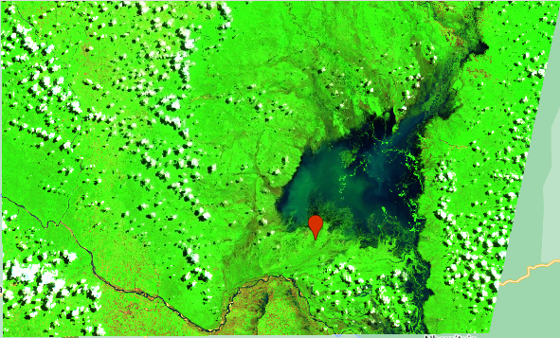
Introduction/Background
Gorongosa
Mar, 05
Mar, 30

Slide 6
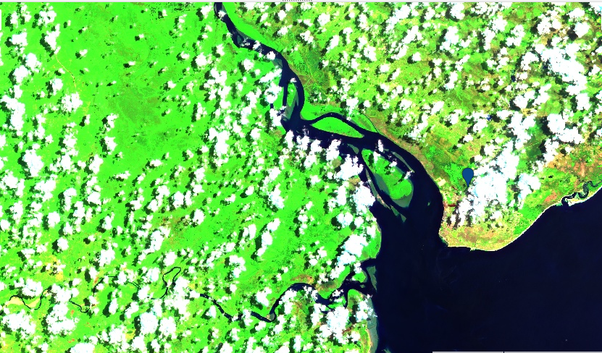
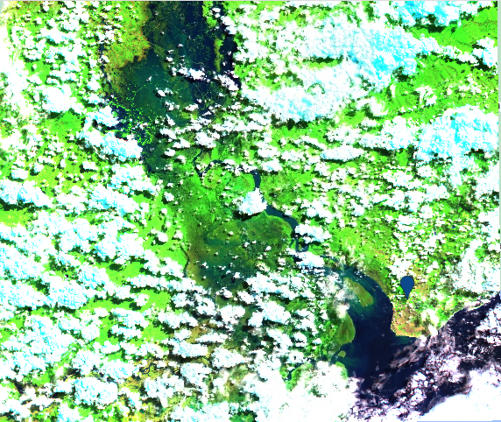
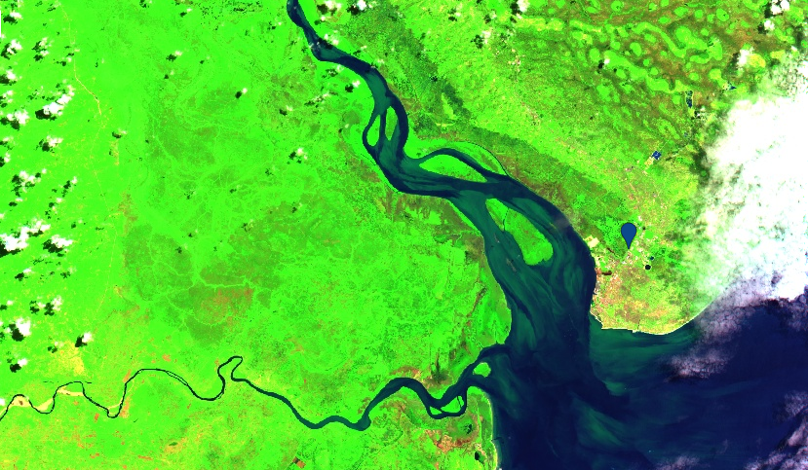
Introduction/Background
Mar, 2
Mar, 12
Beira
Mar, 27

Slide 7
Objectives/Statement of the Problem
To evaluate the extent of damage using Sentinel 1 images
Evaluate number of people/ homesteads/ population affected
Use available, freely accessible datasets in Google Earth Engine
Collaborate reported metrics reported

Slide 8
Methodology (Data & Methods), Implementation Plan/Activities
Data Set Name | Type | Availability
Sentinel 1 | Radar Data | 2014 - present
Chirps | Rainfall Data | 1981 - present
WorldPop Global Project Population Data | Population Data | 2000 - 2021

Slide 9
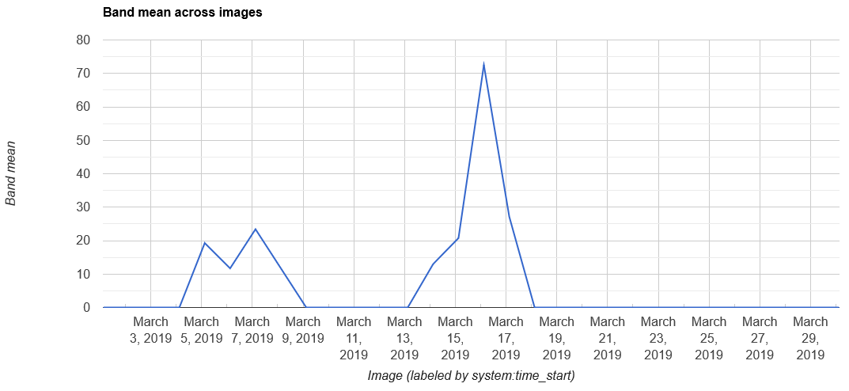
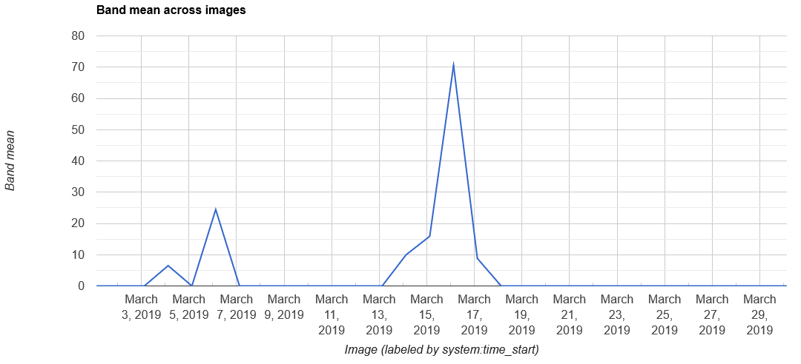
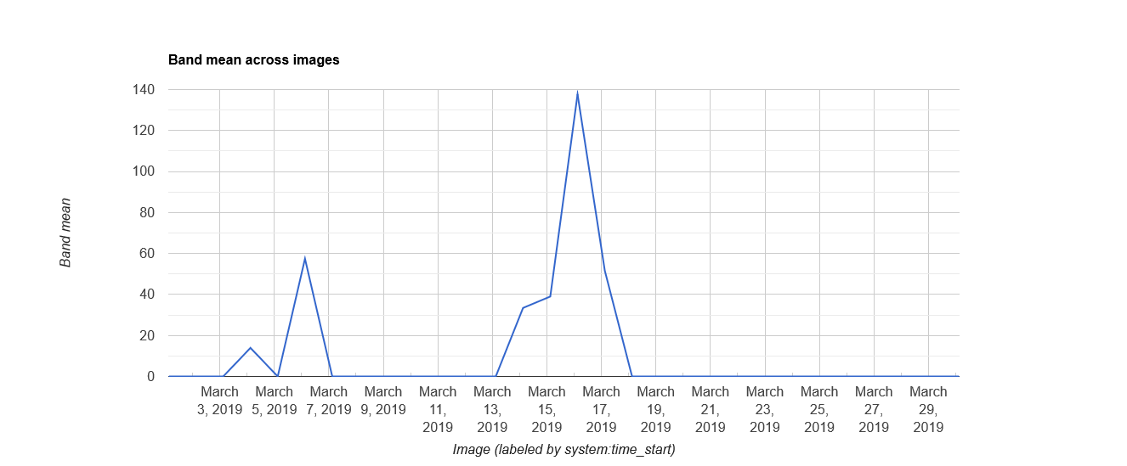
Final or Preliminary Results/Outputs

Slide 10
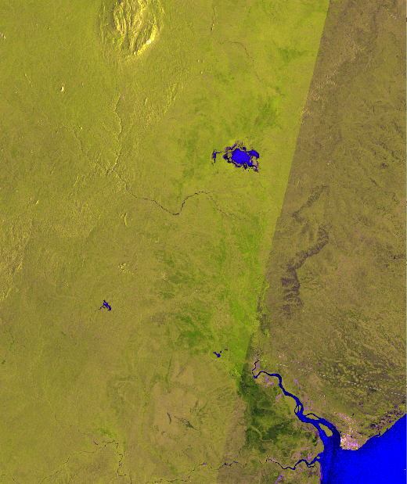
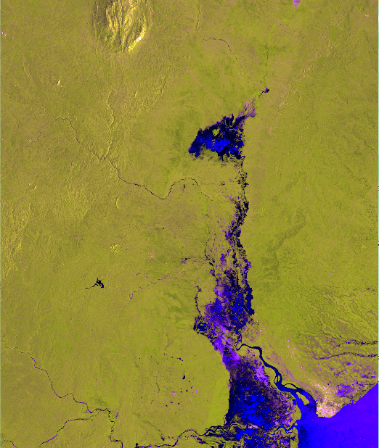
Final or Preliminary Results/Outputs

Slide 11
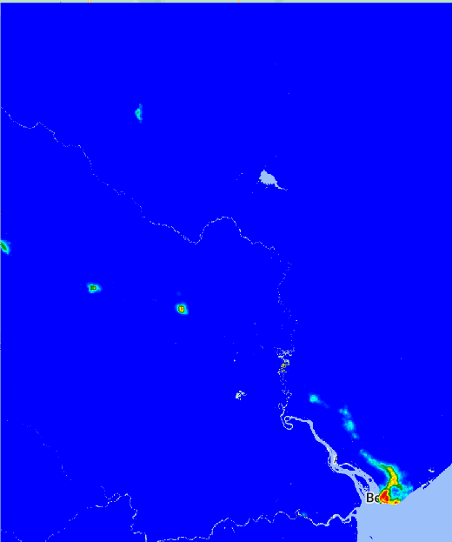
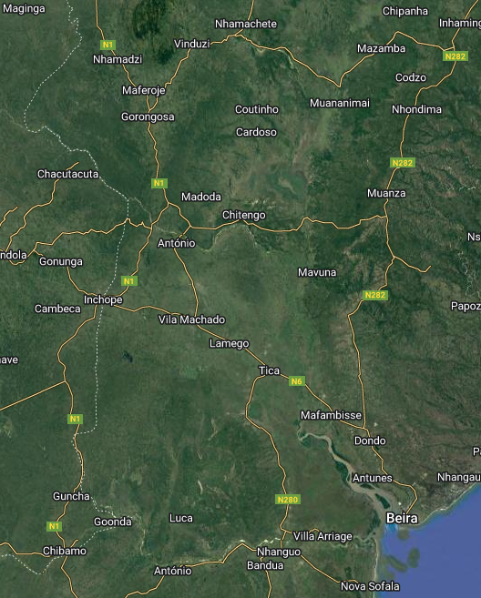
Final or Preliminary Results/Outputs
Entire Population represented = 4,721,997

Slide 12
Quiz
Here is a link to the code that generated the information above
The task is to quantify the number of people affected based on the data provided.
NB: Most of the sections are commented out and some lines not included. It will be up to you to figure out which lines to uncomment and add for you to get to the desired outputs.
https://code.earthengine.google.com/429bcf34a0701ade30d7c020c7c2d0b1

Slide 13
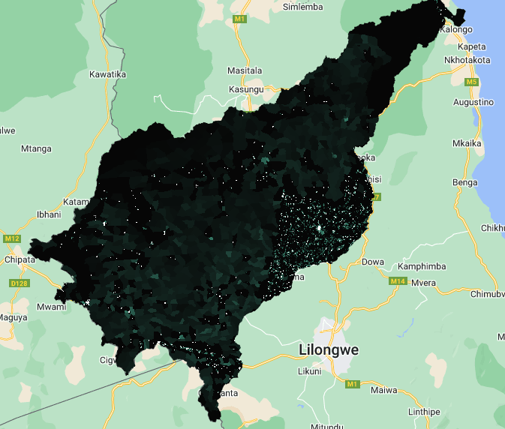
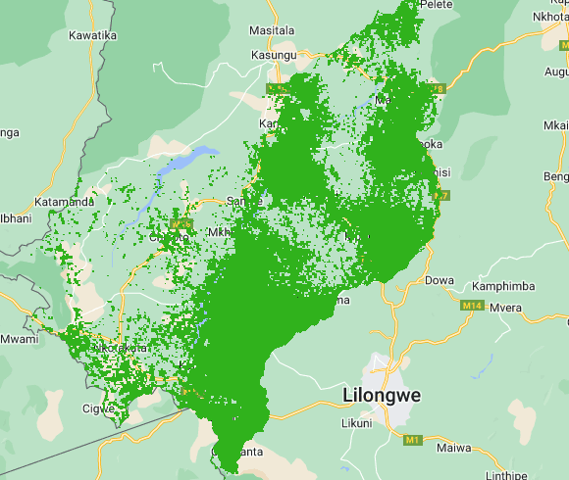
Conclusion/Expected Outcomes
Malawian Population Affected
Malawian Cropland Cover Affected

Slide 14
Expected/proposed application areas of the research/product/tool/service
A land cover map can enhance the analysis of land cover types that have been affected
Socio-economic data would help quantify the damage – bridges destroyed, road blocked
A historical analysis of flood episodes assessment

Slide 15
Acknowledgement (Optional)
James Nyaga – jnyaga@rcmrd.org
Calvince Wara² - cakello@rcmrd.org
(1) RCMRD, Kenya
(2) RCMRD, Kenya.

Slide 16
Thank you
Questions?

